Slide 1
IoT Botnet Detection Based on Anomalies
of Multiscale Time Series Dynamics
Paper Review
Md Minhazul Islam Rimon
ID: 20101078
Course: CSE438
Section:1

Slide 2
Topics
Introduction
Data Processing
Methodology
Botnet Characteristics
Dataset Characteristic
Detection Method Characteristic
Result
Future Work
Reference

Slide 3
Introduction
What is Botnet
What does it do
Effects
Solution
Research Question

Slide 4
Data Processing
Steps
The Ordinal Patterns Transformation
Derived Transformations
Ordinal Patterns Probability Distribution
Ordinal Patterns Transition Graph
Numerical Analysis
Permutation entropy.
Normalized permutation entropy
Statistical complexity
Fisher information

Slide 5
Methodology
Dataset : N-BaIoT public dataset
Botnets : Mirai and Bashlite botnet families
Detection : Kitsune network intrusion detection system

Slide 6
Botnet Characteristics
Mirai Botnet Attacks
Ack Flooding
SCAN
SYN Flooding
UDP Flooding
UDP PLAIN
Bashite Botnet Attacks
SCAN
TCP Flooding
UDP Flooding
JUNK
Combo

Slide 7
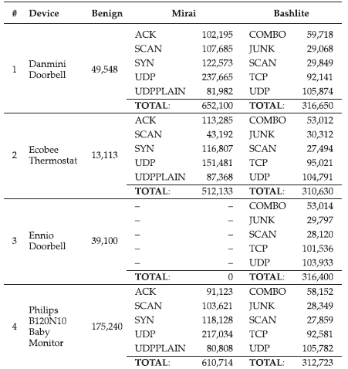
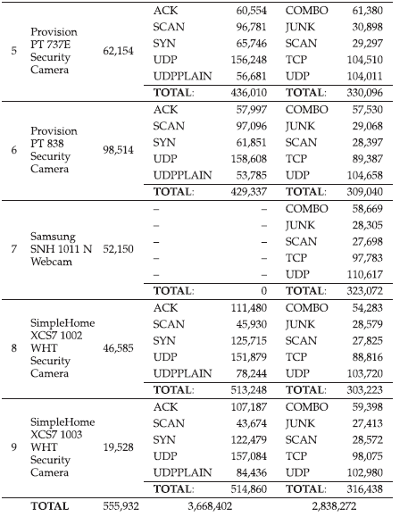
Dataset Characteristics
Fig 1: Dataset Units [1]

Slide 8
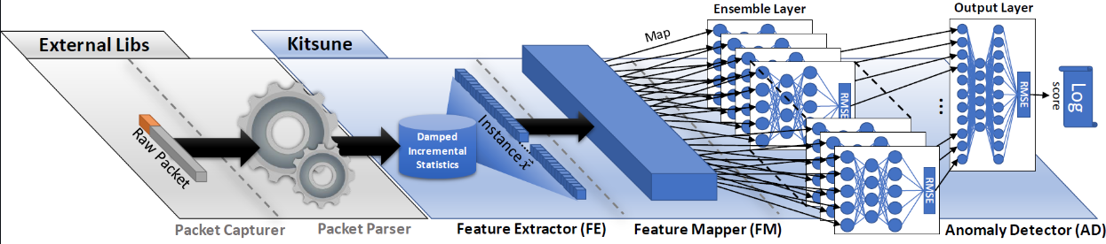
Detection Method Characteristic
Kitsune
A novel ANN-based NIDS which is online, unsupervised, and efficient
An ensemble of small neural networks
Trained to mimic (reconstruct) network traffic patterns
Fig 2 : Kitsune Workflow [2]

Slide 9
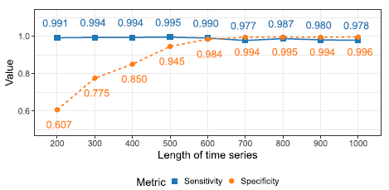
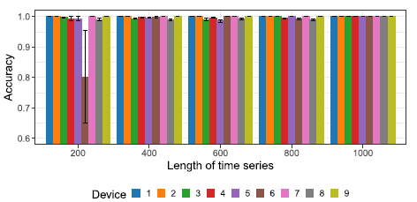
Result
One Model For All Device
One Model Per Device
Fig 3 : One model for all sensitivity and specificity result [1]
Fig 4 : Accuracy Result for One model per Device Experiment [1]

Slide 10
Future Work
Reduce Dependency On Time Series
Way To Transfer Current Method To Future Improved Devices
Other Devices For Botnet Detection
Test Under Different Scenarios

Slide 11
Reference
IoT Botnet Detection Based on Anomalies of Multiscale Time Series Dynamics | IEEE Journals & Magazine | IEEE Xplore
GitHub - ymirsky/Kitsune-py: A network intrusion detection system based on incremental statistics (AfterImage) and an ensemble of autoencoders (KitNET)

